Slide 1
ROUND ROBIN OPTIMIZATION
2K19/CO/319
RITIK SINGH

Slide 2
INTRODUCTION
Scheduling is one of the core functions of an Operating System
It is the method that assigns processes to the CPU so that they can be executed.
When more than one process is waiting to be executed, the scheduler utilizes a scheduling algorithm to make the decision of which process to run next.
In an operating system, many different processes compete for CPU time at any given moment.

Slide 3
SCHEDULING CRITERIA
Fairness: All processes must fairly get the CPU and no one gets into starvation.
CPU utilization: is the percentage of time CPU remains busy.
Throughput: Increase the number of processes that have finished their execution within a certain time interval.
Response time: It is the time when request is submitted for the process till the first response of the process is produced.
Waiting time: It is the time a process spends in ready queue.
Turnaround time: It is the time from submission of the request till the time it is completed. It must be kept minimum.
Context Switch: is the process of swap-out the pre-executed process from CPU and swap-in a new process to CPU.

Slide 4
SCHEDULING OPTIMIZATION CRITERIA
Min waiting time: don’t have process wait long in ready queue
Max CPU utilization: keep CPU busy
Max throughput: complete as many processes as possible per unit time
Min turnaround time: complete as fast as possible
Min response time: respond immediately
Fairness: give each process (or user) same percentage of CPU

Slide 5
ROUND ROBIN ALGORITHM
The Round Robin Scheduling Algorithm is a type of scheduling algorithm mainly used by the operating system and applications that serve multiple clients that request to use resources.
Each process is arranged in the ready queue in a first-come first-served manner, and the processor executes the task from the ready queue on the basis of a time slice.
Even though the process might not have finished execution, once the time slice ends, the process is pushed to the back of the ready queue and the next process starts executing.
It does this repeatedly until the jobs are finished

Slide 6
CHARCARTERISTICS OF RR ALGORITHM
Round robin is a pre-emptive algorithm
The CPU is shifted to the next process after fixed interval time, which is called time quantum/time slice.
The process that is preempted is added to the end of the queue.
Time slice should be minimum, which is assigned for a specific task that needs to be processed. However, it may differ OS to OS.
It is a real time algorithm which responds to the event within a specific time limit.
Round robin is one of the oldest, fairest, and easiest algorithm.
Widely used scheduling method in traditional OS.

Slide 7
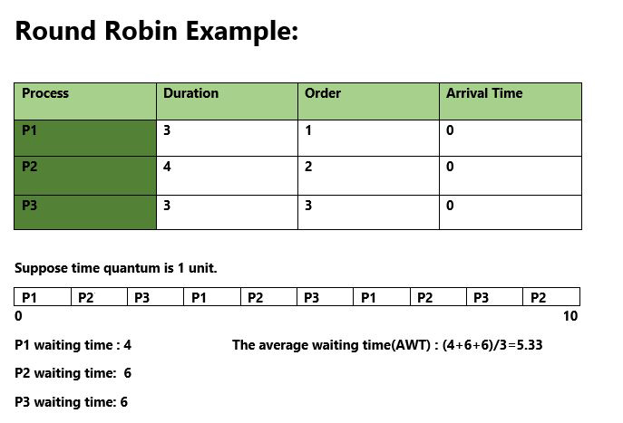
EXAMPLE OF ROUND ROBIN

Slide 8
DISADVANATGES OF ROUND ROBIN
Poor average waiting time when jobs have similar lengths
Imagine N jobs each requiring T time slices
RR: all complete roughly around time N*T
Average waiting time is even worse than FCFS!
Performance depends on length of time slice
Too high ➔ degenerate to FCFS
Too low ➔ too many context switch, costly
How to set time-slice length?

Slide 9
OPTIMIZATED OF ROUND ROBIN
The proposed algorithm is similar to traditional Round Robin algorithm with a small improvement.
In our proposed algorithm, we are arranging the processes in ascending order according to their burst time present in the ready queue.
Step 1: Start
Step 2: Enter the process number, arrival time and arrival time
Step 3: Make a ready queue of the processes
Step 4: Arrange the processes in ascending order based on their burst time
Step 5: Start executing the processes in the arranged manner
Step 6: END

Slide 10
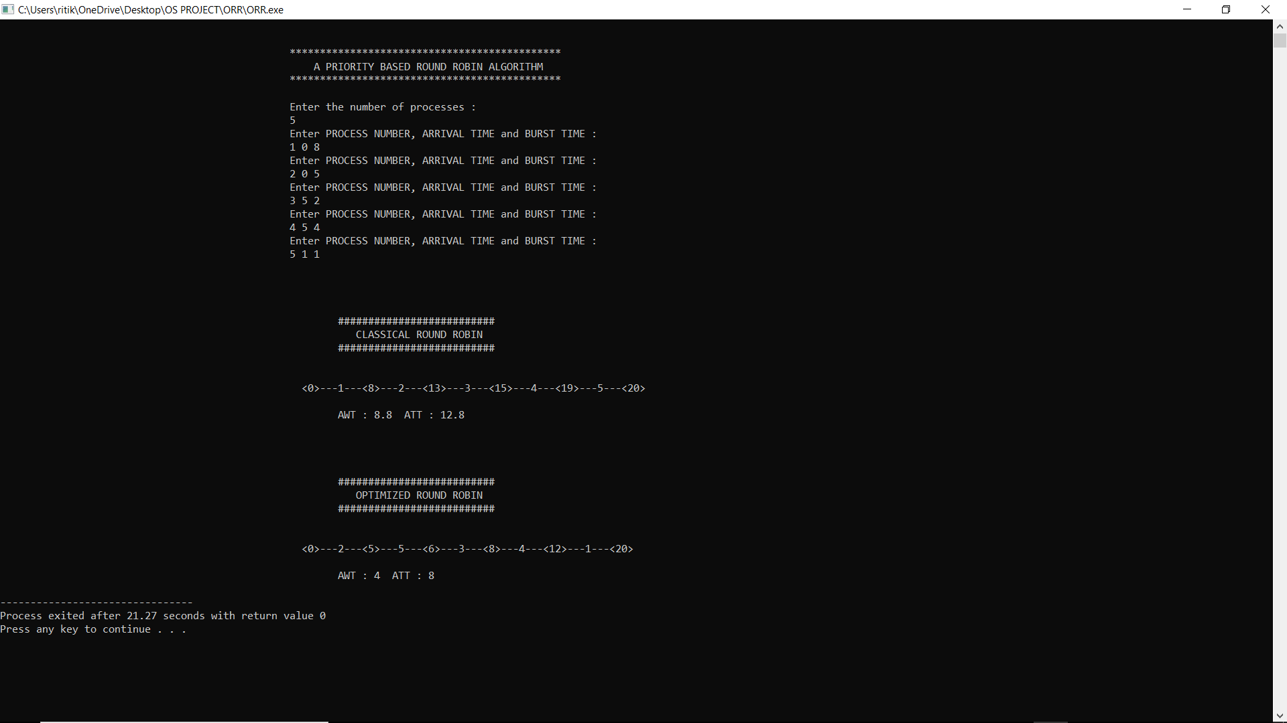
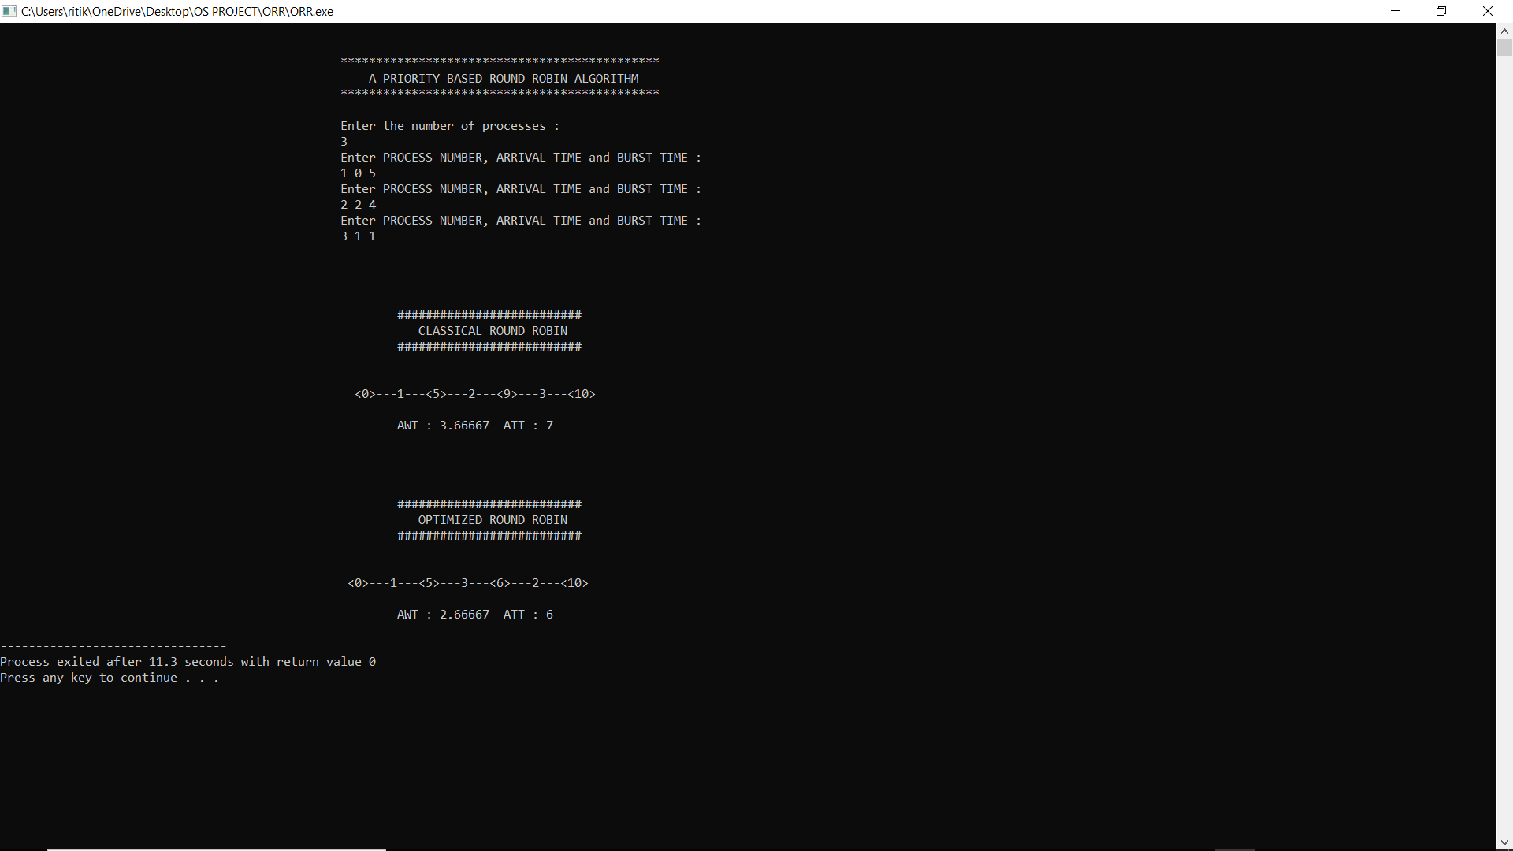
OUTPUT

Slide 11
THANK YOU

